Slide 1
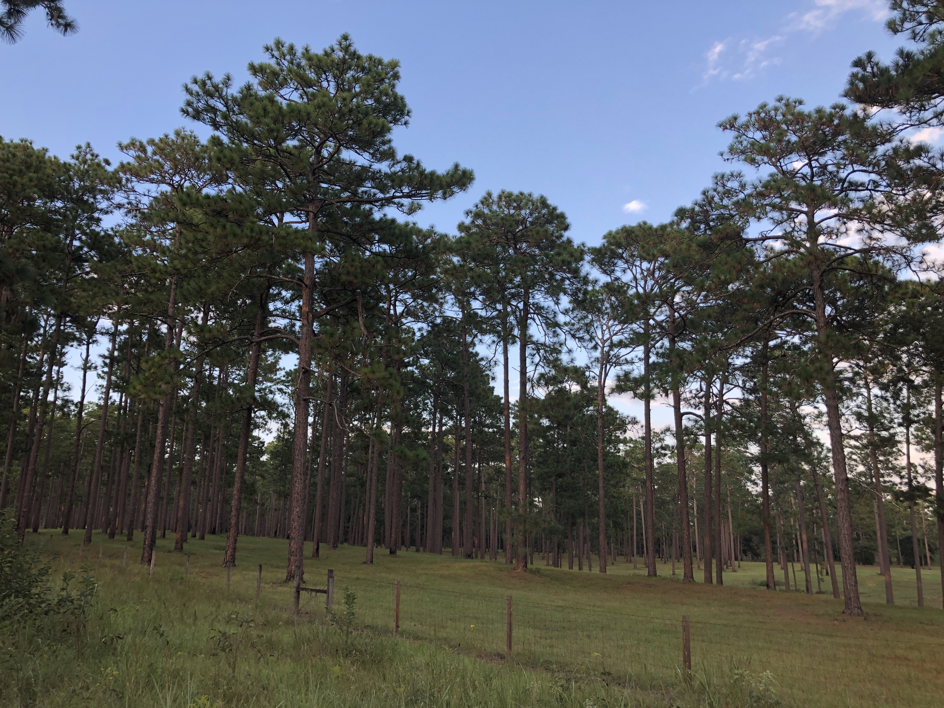
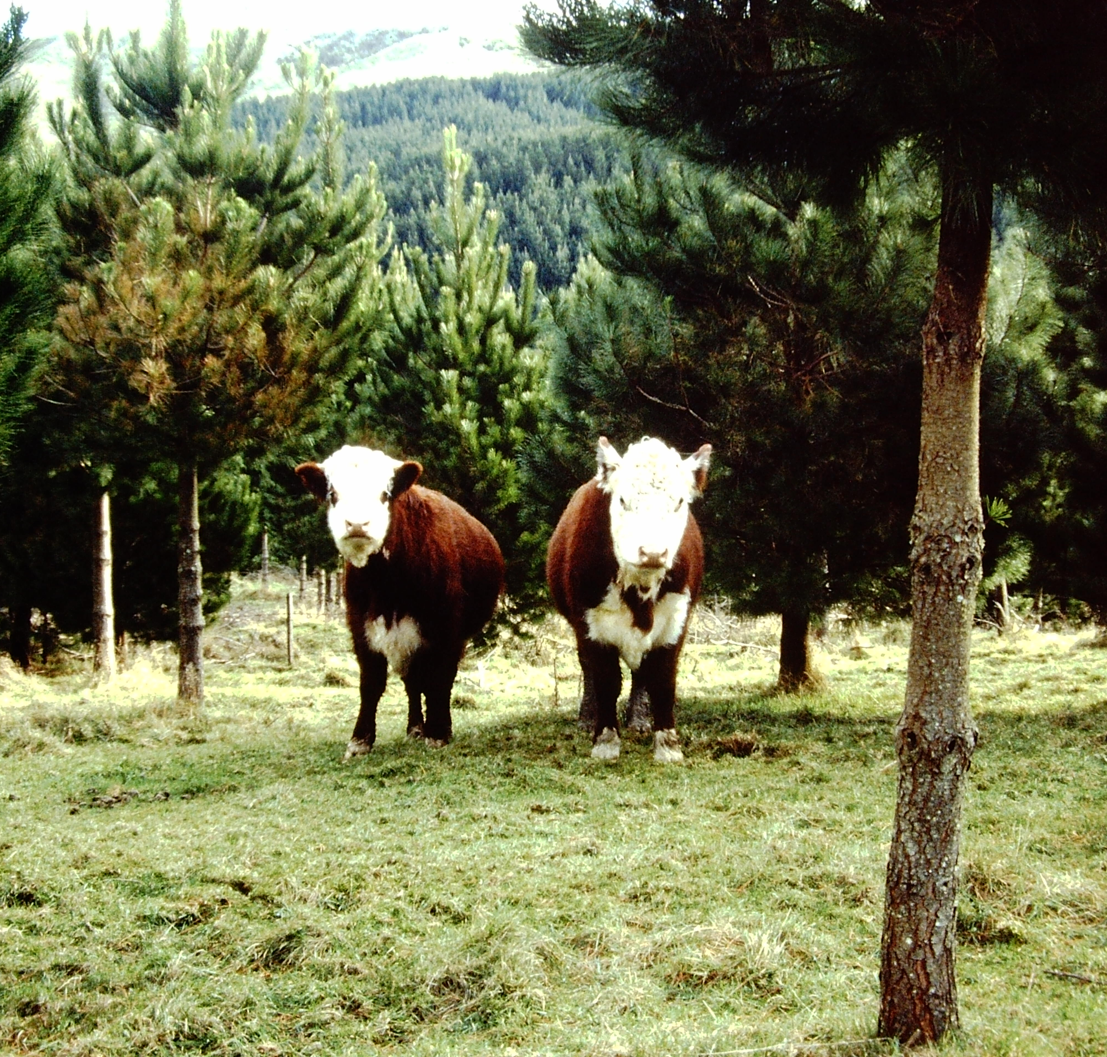

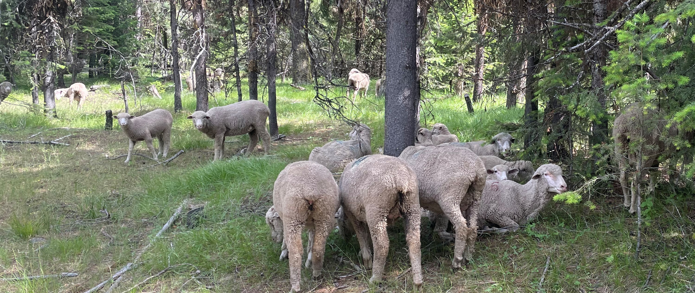
Presenter Name
Soil Health in Silvopasture Systems
Notes:
Photo credits: Tom Sauer and Nick Sirovatka, Soil Health Division

Slide 2
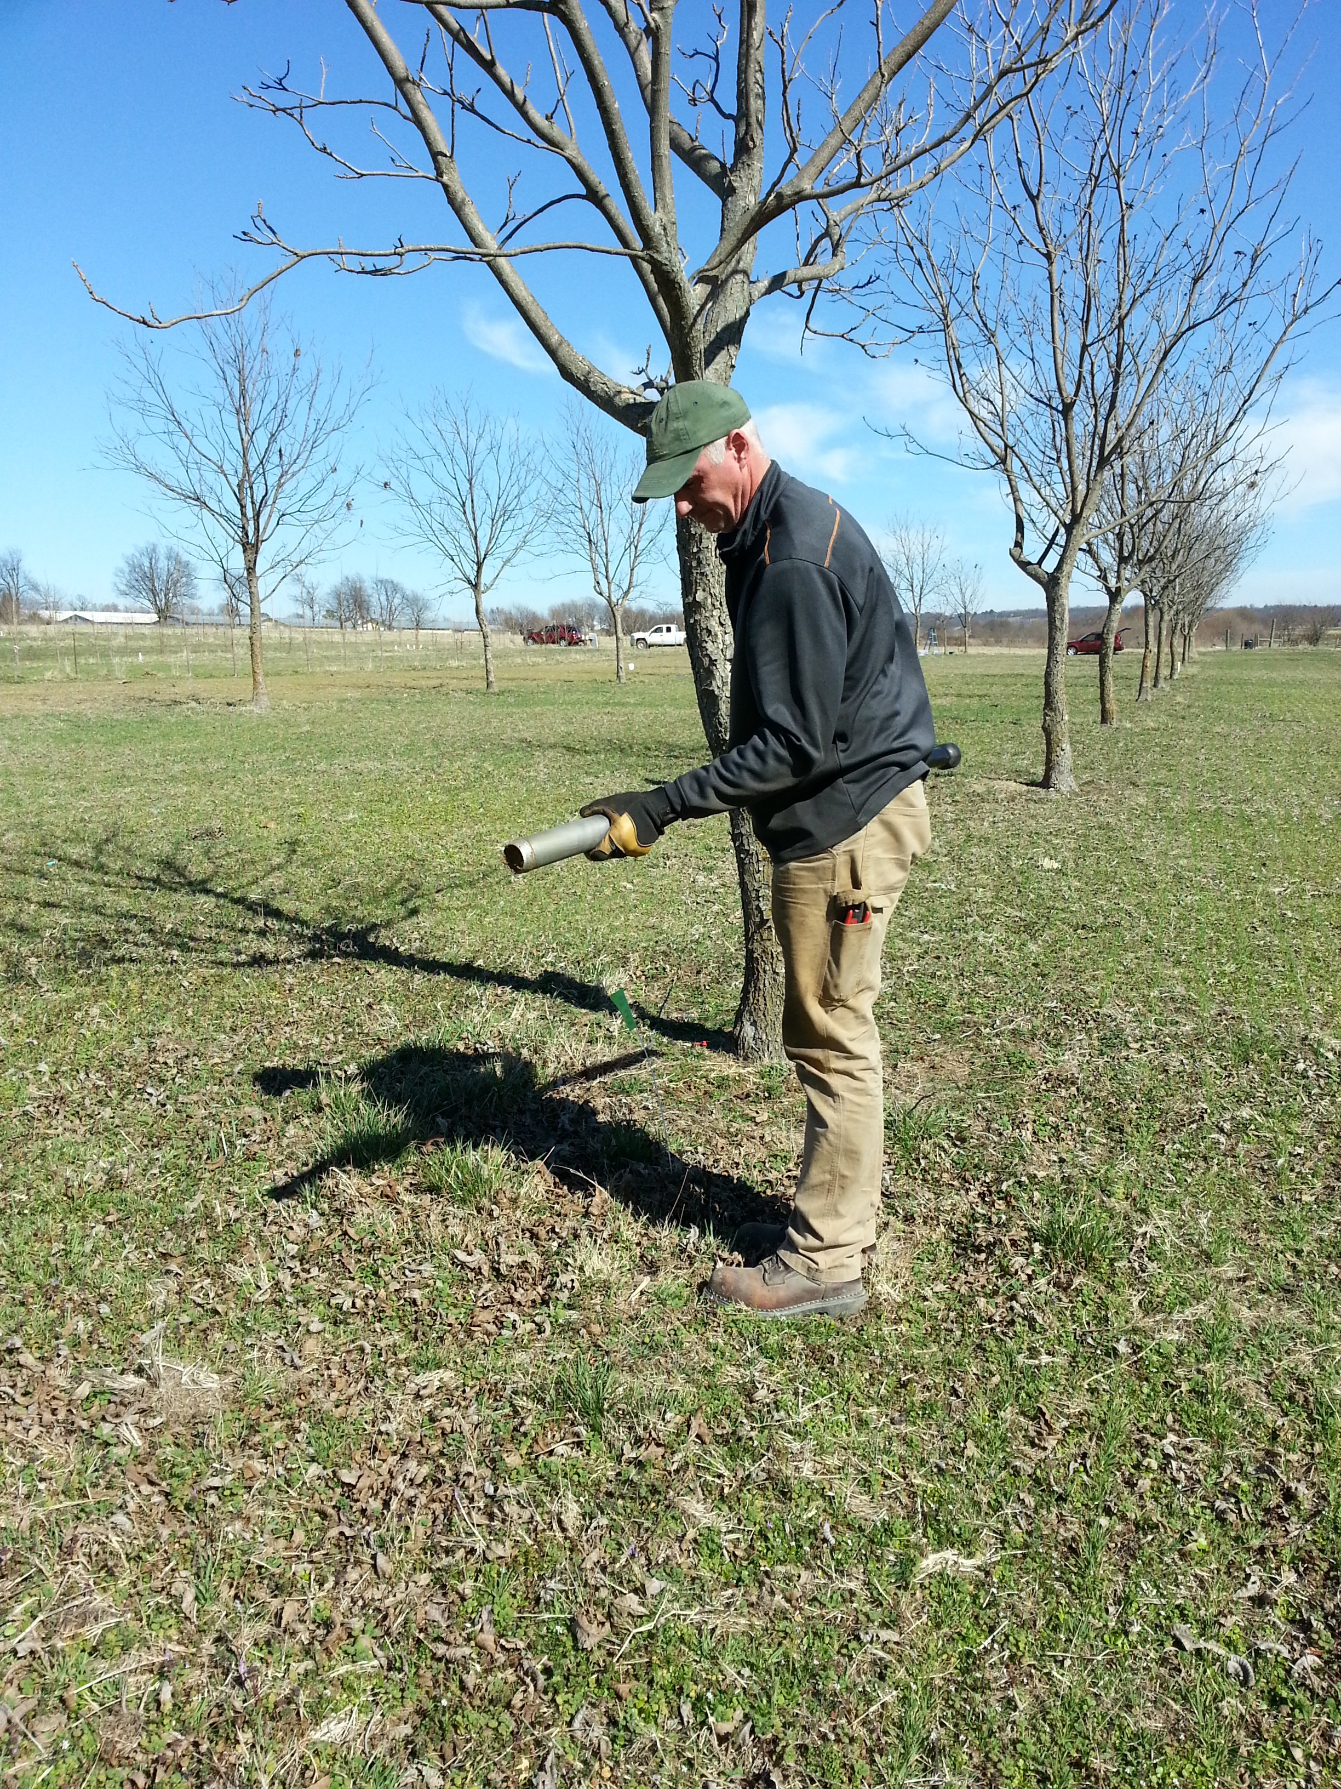
Objectives
Introduce soil health principles and resource concerns
Develop understanding of soil biological, physical, and chemical health and their interactions in silvopasture systems
Identify management impacts on silvopasture soil health
Identify strategies to utilize soil health
principles to enhance silvopasture
management for soil health
Notes:
This module follows on from the introduction to silvopasture module that presented aspects of establishment and management of silvopastures. The focus of this module is on soil health aspects.

Slide 3
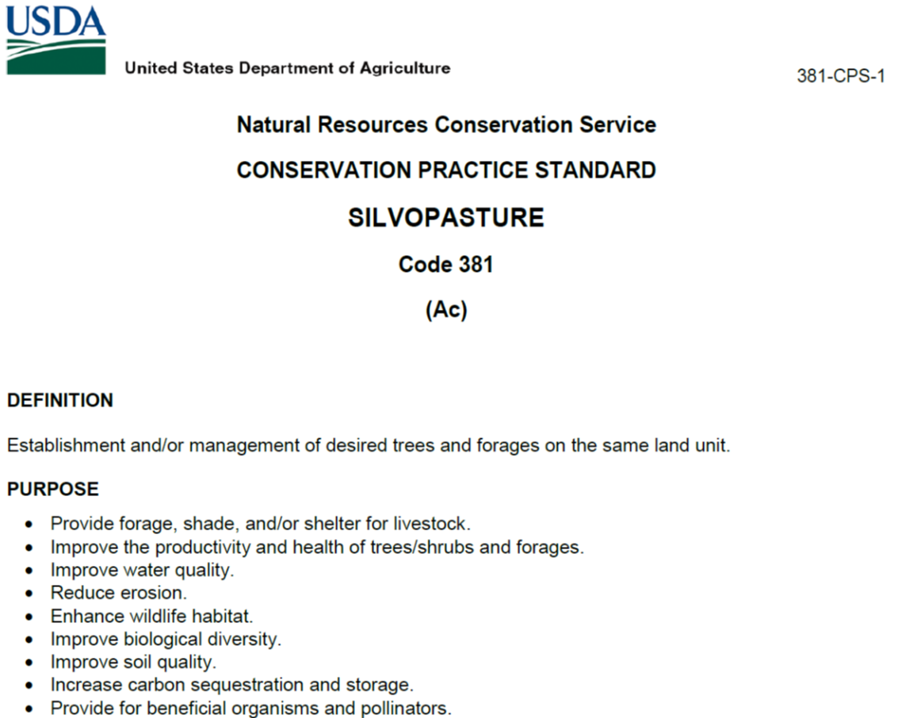
Silvopasture CPS 381
Notes:
Note the purposes listing in the silvopasture conservation practice standard. Several are closely aligned with soil health principles. Timber production is not one of the purposes listed.
The choice of tree and forage species will affect the delivery of soil health benefits and ecosystem services delivered.

Slide 4
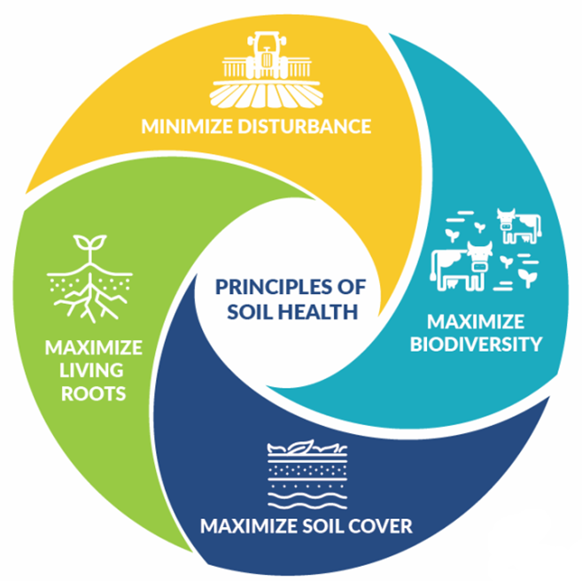
Soil Health Principles and Resource Concerns
How Each of these can contribute to alleviating
Each of these
Aggregate Instability
Compaction
Organic Matter Depletion
Soil Organism Habitat Loss or Degradation
Notes:
Training goal is to relate soil health principles to address resource concerns in silvopasture systems.
As other modules of this training focus on forage and grazing aspects of silvopasture soil health, this module will focus more on the tree component of silvopastures as they relate to soil health.

Slide 5
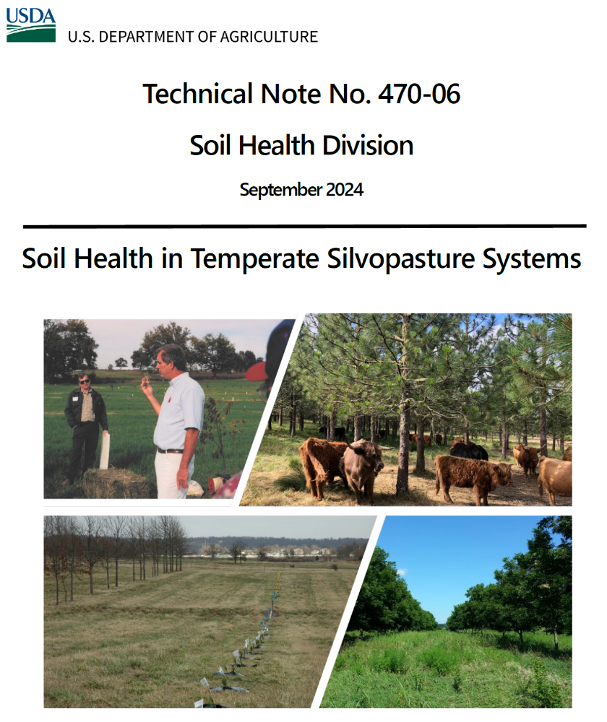
Silvopasture Soil Health Tech Note
Notes:
This new Soil Health Division technical note focuses on soil health in temperate silvopastures.

Slide 6
Temperate Silvopasture Soil Biological Health
Notes:
The tech note breaks soil health into biological, physical, and chemical components and this format is following in the module. It should be noted that the interaction among the various aspects of soil health are complex but need to be considered in a holistic manner. For example, a soil with “unhealthy” physical soil health ( compacted, poor structure, low aggregate stability) is unlikely to be healthy overall due to the constraints that the poor physical health place on the biological and chemical health.

Slide 7
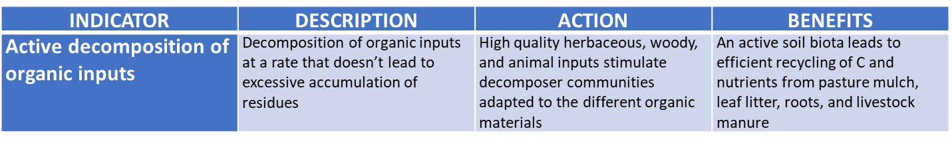
Active Decomposition
Notes:
This is a “Goldilocks” indicator. Decomposition should occur at a rate where there may be some litter accumulation during the year but no excessive build up from multiple years of accumulation or complete consumption of all litter.

Slide 8
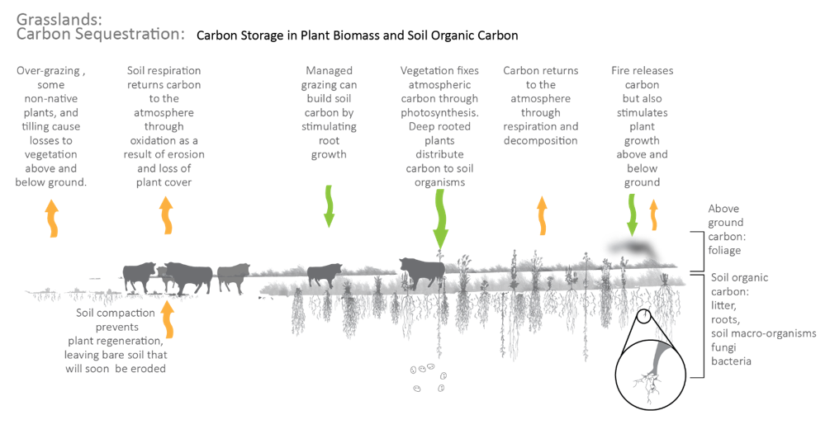
Pasture Carbon Cycling
https://bwsr.state.mn.us/carbon-sequestration-grasslands
Notes:
Grassland carbon cycling when grazing animals are included is more complex and involves shorter time spans for cycling between carbon pools. Overgrazing removes more carbon in the biomass and may degrade the soil, depleting it of carbon and reducing its ability to support forage growth. Good grazing management should stimulate carbon accumulation via photosynthesis, putting carbon into root growth and forage production. Some consumed carbon is removed by the livestock and some is returned to the soil as manure. If fire occurs, carbon is initially lost but fire may also stimulate forage growth by consumption of mulch and release of some mineral nutrients.
Good grazing management should allow for belowground carbon accumulation.

Slide 9
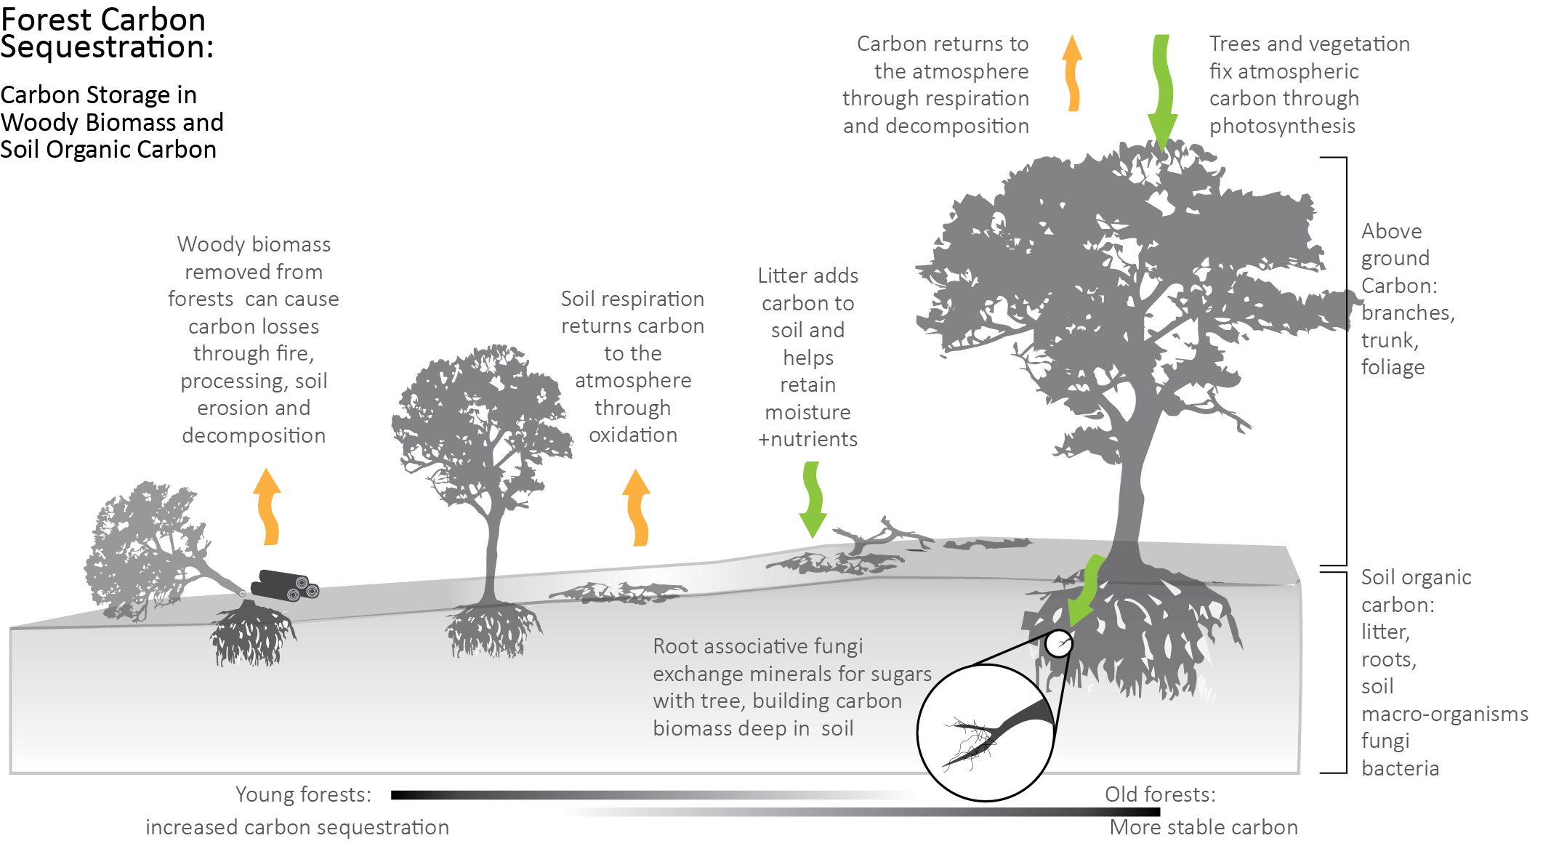
Forest Carbon Cycling
https://bwsr.state.mn.us/carbon-sequestration-forests
Notes:
Forest can have long periods (decades to centuries) of carbon accumulation in biomass, the forest floor, and soil. Carbon can be released (fire) or removed (harvest) in short periods of time starting the cycle over again.
Although much attention is given to the aboveground/visible carbon stored in forest canopies, approximately 50% of forest carbon is contained in the soil.

Slide 10
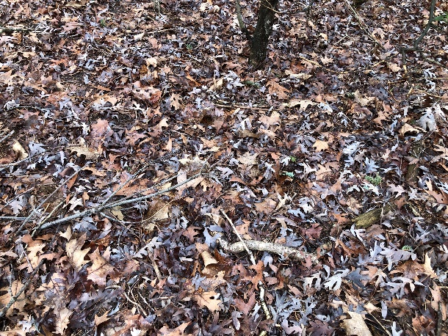
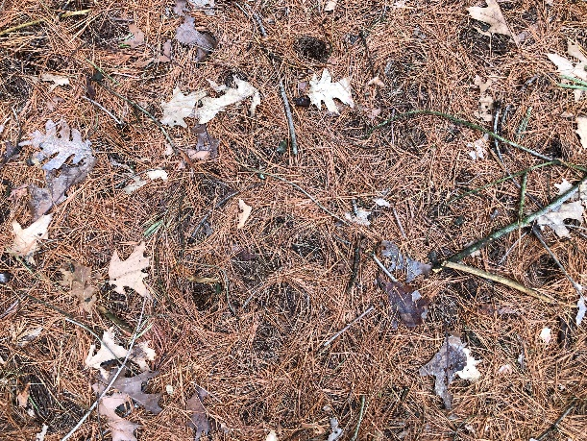
Temperate Deciduous vs Coniferous Litter
Deciduous
Coniferous
Most leaves drop in fall (some carry leaves through winter)
Litterfall: 5.5 t ha⁻¹ yr⁻¹ (2.4 T/A/yr)
Forest floor: 18 t ha⁻¹ (8 T/A) Mull type (mixed organic/mineral, bacterial decomposition, granular)
Turnover rate: 4 yrs.
Periods or continuous partial needle drop (10-50% / year)
Litterfall: 3.5 t ha⁻¹ yr⁻¹ (1.6 T/A/yr)
Forest floor: 45 t ha⁻¹ (20 T/A) Mor type (matted, undecayed, low pH, fungal decomposition, distinct boundary)
Turnover rate: 15 yrs. (high C/N, lignin/N)
Adams et al., 2019. https://doi.org/10.1016/B978-0-444-63998-1.00006-9
Notes:
Litter deposition and decomposition are important aspects of carbon cycling in forest systems. Litter from deciduous and coniferous trees have differing amounts and properties that affect how quickly the fallen leaves and needles decompose and cycle carbon and nutrients in the soil.
Adams, M. B., C. Kelly, J. Kabrick, and J. Schuler. 2019. Temperate forests and soils. pp. 83-108 In: Global Change and Forest Soils https://doi.org/10.1016/B978-0-444-63998-1.00006-9.
Pine needle drop p. 58:
Kozlowski, T. T. and S. G. Pallardy. 1997. Physiology of Woody Plants. 2nd Ed. Academic Press, New York. 411 pp.
Berg, B. and R. Laskowski 2006. Litter Decomposition: A guide to carbon and nutrient turnover. Academic Press. 421 pp.
Deciduous litter (leaves) more like grass/forb litter.

Slide 11
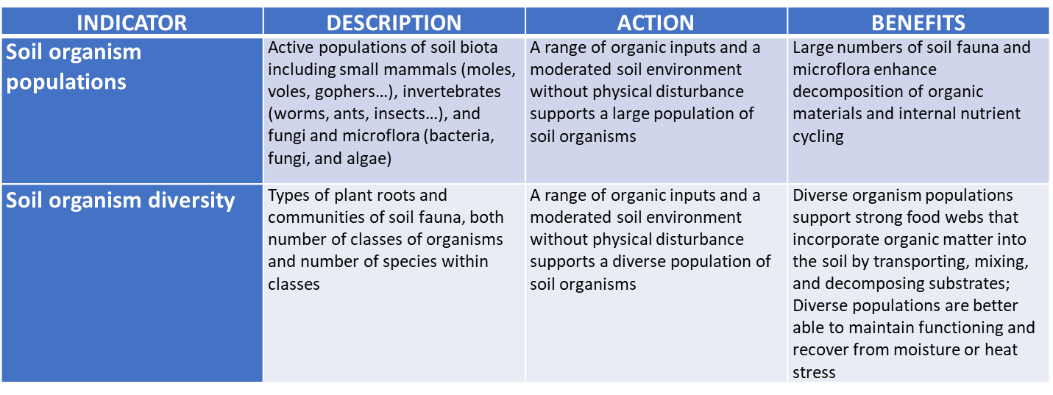
Soil Organisms
Notes:
The number and diversity of soil organisms in the litter layer and soil will affect the decomposition of organic inputs, efficient cycling of carbon, and recycling of nutrients.
The activity of these organisms also contribute to creation of stable soil structure that enhances water flow and storage and aeration.

Slide 12
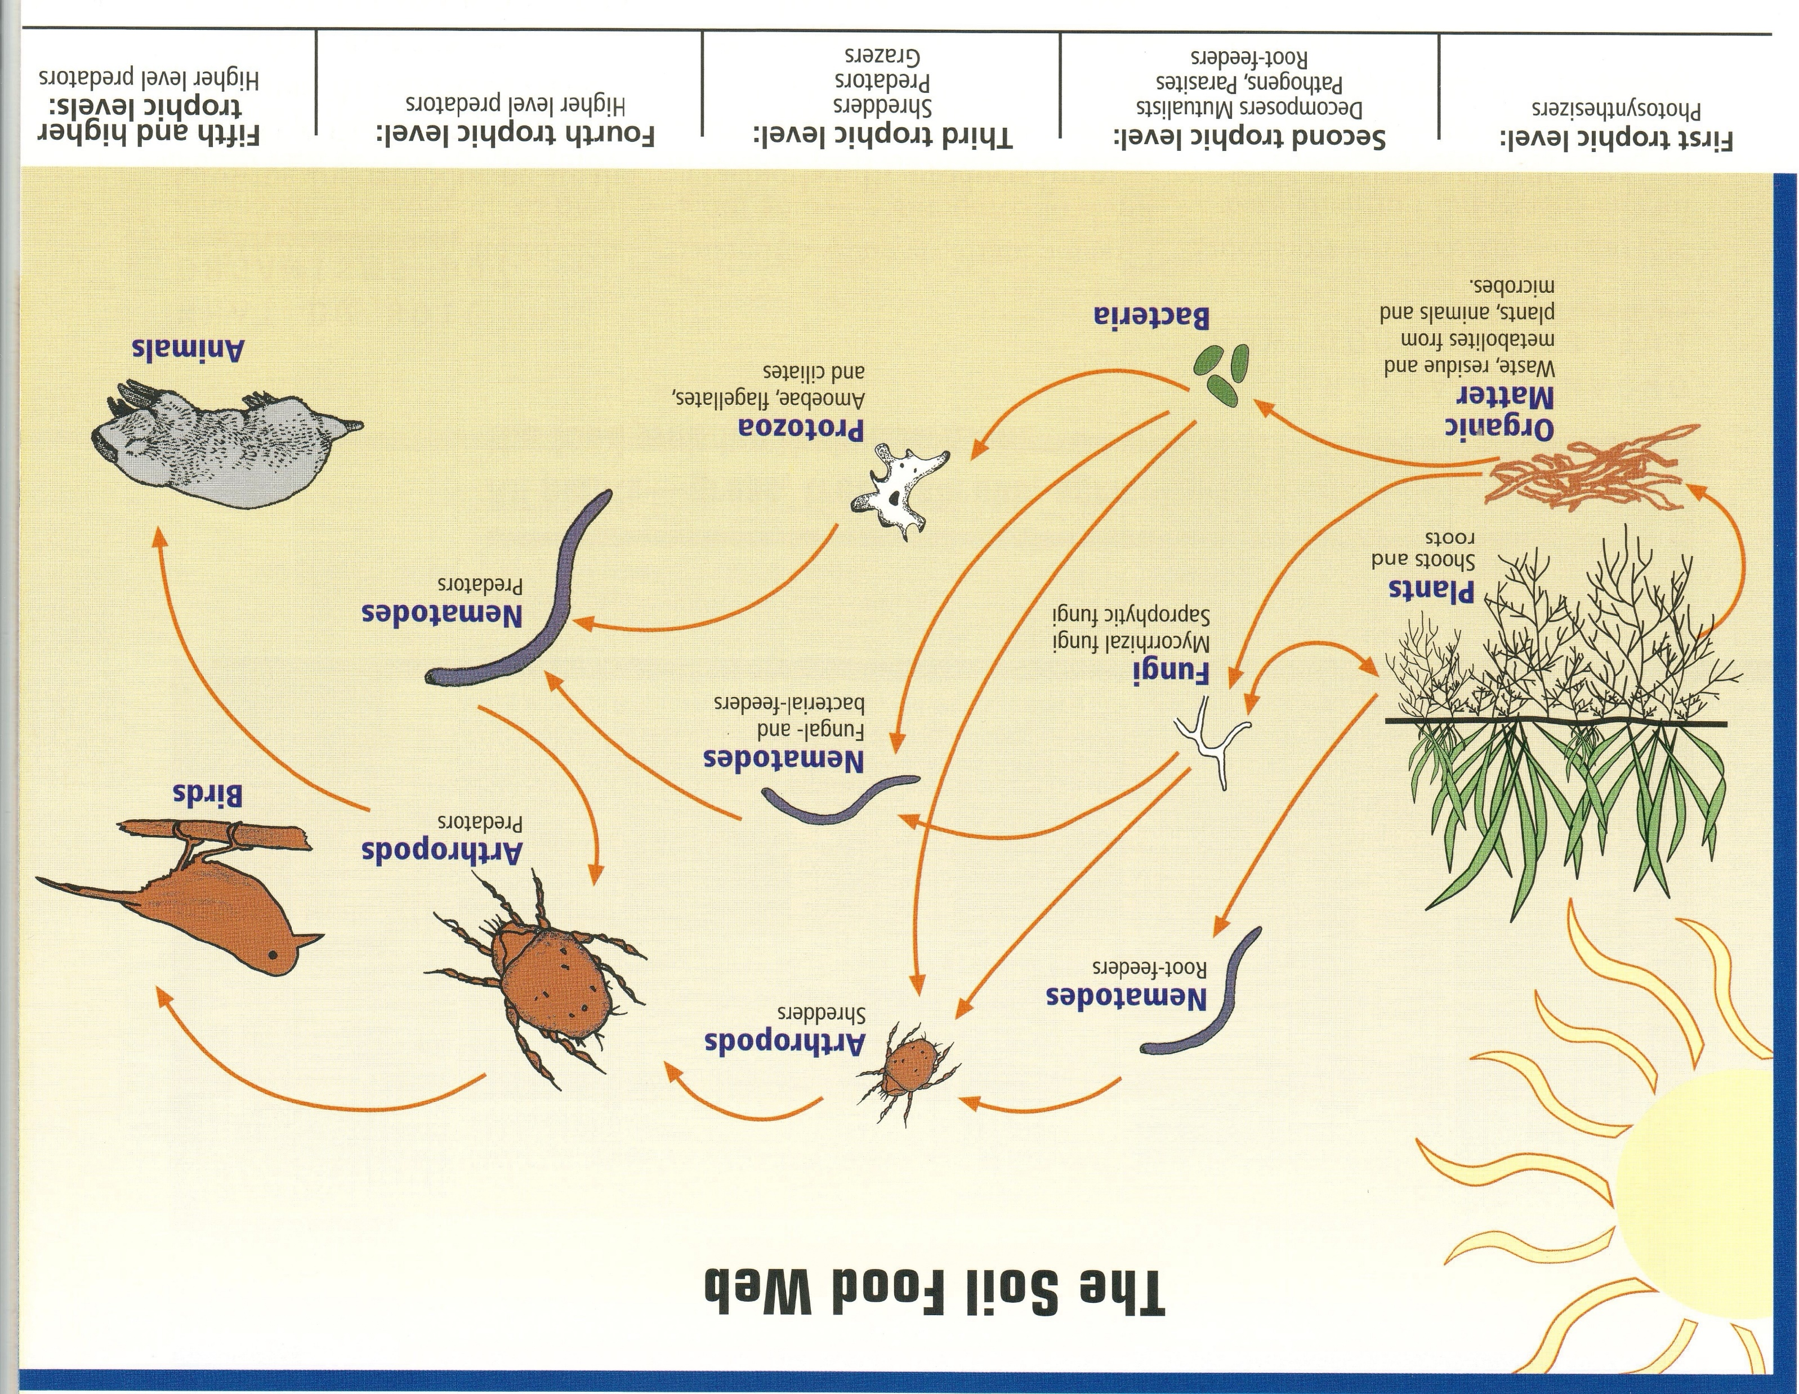
Soil Food Web
Soil and Water Conservation Society. 2000. Soil Biology Primer. 48 pp.​
​
Notes:
Soil and Water Conservation Society. 2000. Soil Biology Primer. 48 pp.

Slide 13
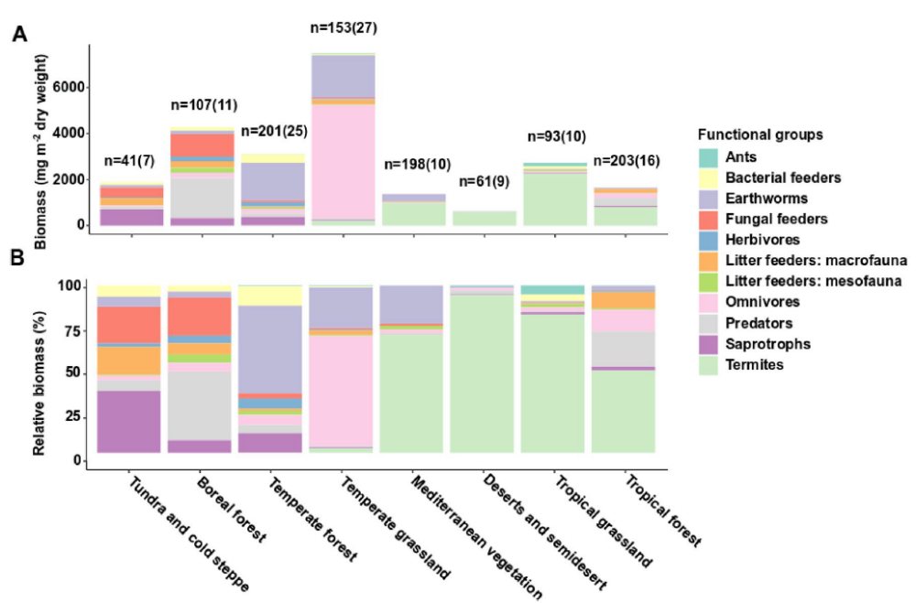
Invertebrate Soil Fauna
Forest: earthworms, bacterial feeders, saprotrophs
Grassland: omnivores, earthworms
Heděnec et al., Scientific Reports. (2022) 12:17362 https://doi.org/10.1038/s41598-022-21563-z
Notes:
This review paper highlights differences in invertebrate soil fauna functional groups among different land covers and climate zones. It is a global analysis so findings may not directly apply to U.S. ecosystems.
Temperate grasslands have greater amount of soil fauna while temperate forests have greater functional diversity.
There is no mention of whether any of the grasslands or forests were grazed by livestock or wildlife.
Petr Heděnec, Juan Jose Jiménez, Jabbar Moradi, Xavier Domene, Davorka Hackenberger, Sebastien Barot, Aline Frossard, Lidia Oktaba, Juliane Filser,
Pavel Kindlmann & Jan Frouz. Global distribution of soil fauna functional groups and their estimated litter consumption across biomes.
Scientific Reports | (2022) 12:17362 | https://doi.org/10.1038/s41598-022-21563-z

Slide 14
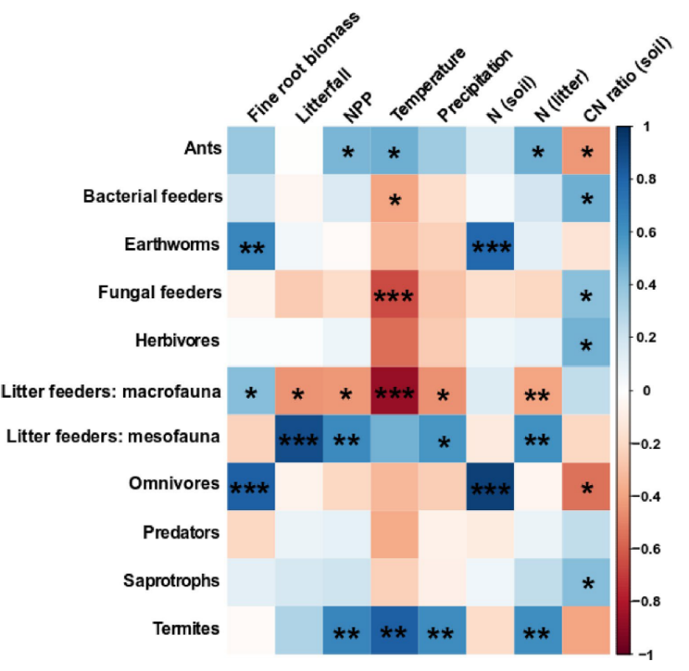
Soil Fauna (Invertebrate) Functional Groups
Bacterial feeders Protists, bacterivorous nematodes, dipteran larvae, rotifers, tardigrades.
Fungal feeders Oribatid mites, collembolans, pauropods, proturans, fungivorous nematodes.
Herbivores Gastropods, hemipterans, homopterans, herbivorous nematodes.
Litter feeding macrofauna Unidentified soil fauna > 2 mm.
Litter feeding mesofauna
Unidentified soil fauna < 2 mm.
Omnivores Blattodea, Dermaptera, myriapods sensu lato, omnivorous nematodes, insects sensu lato (in the broad sense).
Predators Spiders, centipedes,
Mesostigmats, Diplura.
Saprotrophs Saprotrophic nematodes, isopods, milipedes, enchytreids.
> 2 mm
> 0.2 < 2 mm
Blue = pos
Red = neg
Heděnec et al., Scientific Reports. (2022) 12:17362 https://doi.org/10.1038/s41598-022-21563-z
Notes:
Note that increasing temperature (red tinted boxes) has a negative impact on several functional groups, i.e., warmer temperatures lead to lower numbers of most groups except termites, ants, and litter feeding mesofauna.
Petr Heděnec, Juan Jose Jiménez, Jabbar Moradi, Xavier Domene, Davorka Hackenberger, Sebastien Barot, Aline Frossard, Lidia Oktaba, Juliane Filser,
Pavel Kindlmann & Jan Frouz. Global distribution of soil fauna functional groups and their estimated litter consumption across biomes.
Scientific Reports | (2022) 12:17362 | https://doi.org/10.1038/s41598-022-21563-z

Slide 15
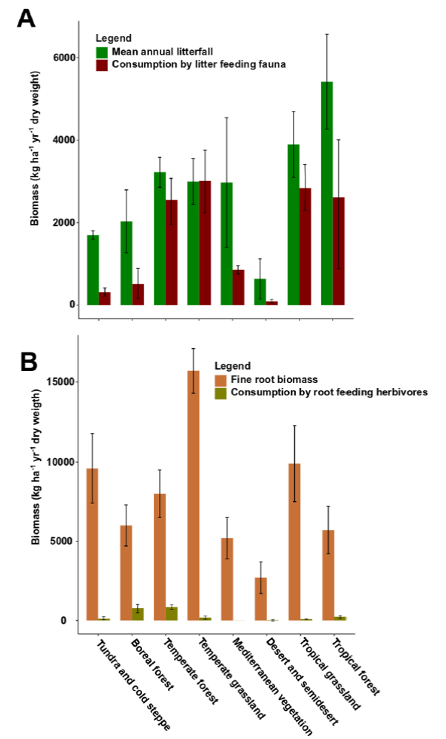
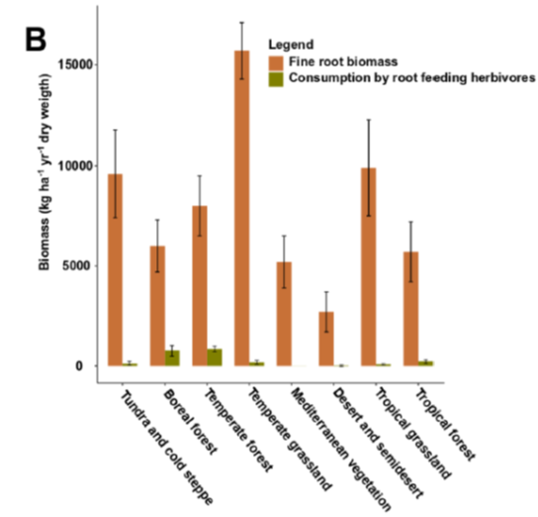
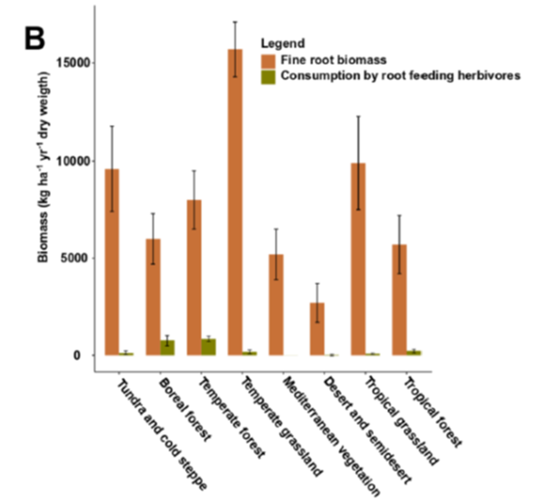
Temperate Forests vs. Grasslands
Litter
Litter feeding fauna consume ~100% of mean annual litterfall in temperate grasslands and ~80% in temperate forests
Roots
More fine root biomass in grasslands and low amount of living fine roots consumed by root feeding herbivores in both grasslands and forests
Heděnec et al., Scientific Reports. (2022) 12:17362 https://doi.org/10.1038/s41598-022-21563-z
Notes:
Most of the annual litterfall is consumed by litter feeding fauna in both temperate grasslands and forests, which produce comparable amounts of annual litterfall.
This contrasts with fine root biomass where only a small proportion of the annual fine root growth is consumed by root feeding herbivores.
Note that temperate grasslands produce significantly more fine root biomass than temperate forests.
Petr Heděnec, Juan Jose Jiménez, Jabbar Moradi, Xavier Domene, Davorka Hackenberger, Sebastien Barot, Aline Frossard, Lidia Oktaba, Juliane Filser,
Pavel Kindlmann & Jan Frouz. Global distribution of soil fauna functional groups and their estimated litter consumption across biomes.
Scientific Reports | (2022) 12:17362 | https://doi.org/10.1038/s41598-022-21563-z

Slide 16
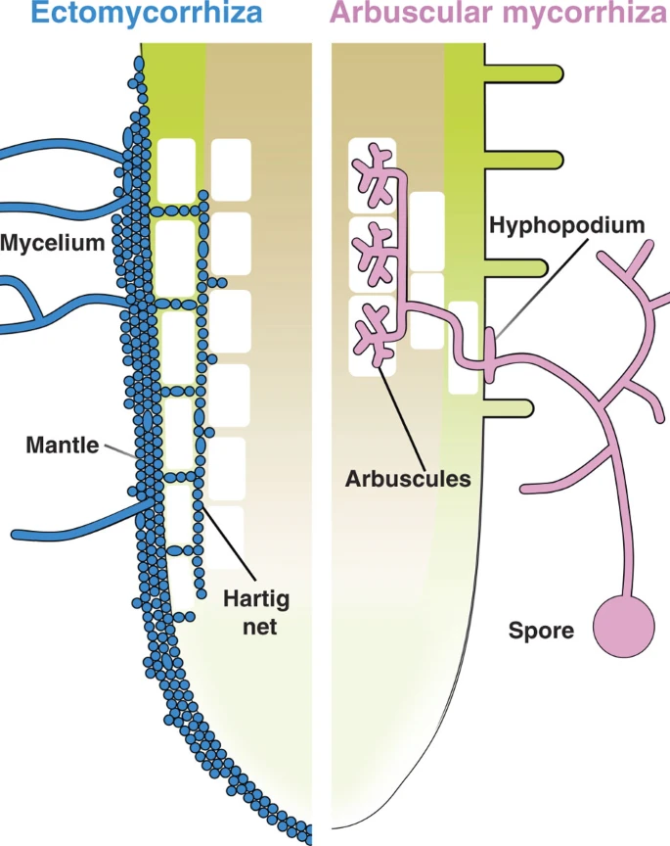
Mycorrhizal Fungi
Ectomycorrhizal Fungi
- Penetrate between root cortical cells
- Almost exclusively found in trees
Assist in OM decomposition
Endomycorrhizal Fungi incl. Arbuscular Mycorrhizae Fungi (AMF)
- Association with >80% of land plants
- Penetrate root cells
- Need living roots to grow
Symbiotic association with plant roots where the fine hyphae greatly enhance nutrient & water uptake, especially during periods of stress (moisture or nutrient)
Bonfante and Genre. 2010. Nature Communications DOI:10.1038/ncomms1046
Notes:
Bonfante, P., and A. Genre. 2010. Mechanisms underlying beneficial plant-fungus interactions in mycorrhizal symbiosis. Nature Communications DOI:10.1038/ncomms1046
Deciduous tree species: some Ecto and AMF
Most conifers Ecto

Slide 17
PLFA and FAME
Phospholipid fatty acids (PLFA) are the primary components of cell membranes of microorganisms (except archaea)
Analysis of soils for PLFA or fatty acid methyl ester (FAME) are common techniques to quantify the amount of microbial biomass in soils
Several indicator PLFA can also be used to determine the composition of important microbial groups
- Fungi vs bacteria (F:B)
- Grasslands and cropland: bacteria-dominated
- Forests: fungi-dominated
Now techniques based on nucleic acid extraction and analysis, gene coding for ribosomal RNA (rRNA)
- greater resolution of a given microbial community
Notes:
Greater amounts of microbial biomass in soils support a larger and potentially more diverse microbial community. The value of most of these tests is in comparing land uses over time. If management practices result in greater microbial biomass that may be interpreted as a positive indicator for soil health.

Slide 18
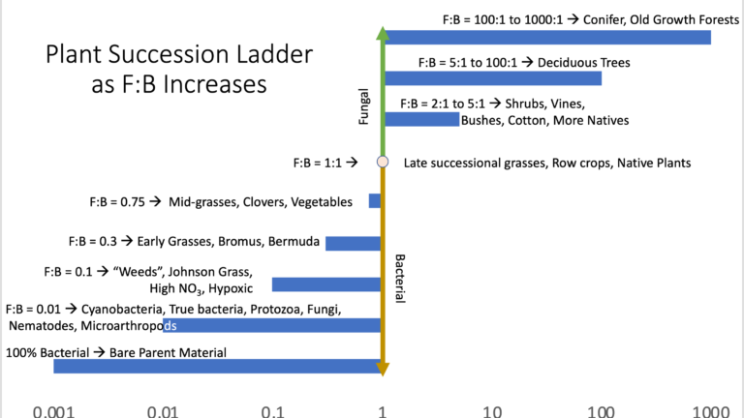
Fungi-to-Bacteria Biomass Ratio
Silvo-
pasture?
>0.35 = “Excellent”
<0.05 = “Very Poor”
Regen Ag Lab, LLC
https://regenaglab.com/
https://microbiometer.com/blog/analyzing-your-fungal-to-bacterial-ratio-results/#:~:text=Highly%20productive%20agricultural%20soils%20tend,1%20in%20a%20coniferous%20forest.%E2%80%9D
Notes:
Different labs/analytical techniques will result in different scales of values and interpretations. Repeated measures using the same techniques are needed to verify results/interpretations. Put more value on relative differences than absolute numbers. Best to use the same analysis.
https://microbiometer.com/
microBIOMETER® is a low cost, 20-minute on-site soil test for microbial biomass and fungal to bacterial ratio that allows you to quickly determine the health of your soil.

Slide 19
Pasture vs. Silvopasture
Poudel et al (2022) 25 yr-old black walnut and honeylocust silvopastures established in pastures in Virginia
Total PLFA and actinomycete abundance were greater in open pasture compared to silvopastures
Arbuscular mycorrhiza fungi (AMF) abundance was also higher in the open pasture compared to the honeylocust silvopasture
Both silvopastures had greater bacterial and lower AMF abundance than the open pasture
The authors noted that these results were inconsistent with results from subtropical and tropical silvopastures where greater microbial community abundance is often observed in silvopastures than in open pastures
Poudel et al., 2022. Agroforestry Systems 96:1237-1247 https://doi.org/10.1007/s10457-022-00783-2
Notes:
Poudel, S., S. Bansal, S. Podder, B. Paneru, S. Karki, J. Fike, and S. Kumar. 2022. Conversion of open pasture to hardwood silvopasture enhanced soil health of an ultisol. Agroforestry Systems 96:1237-1247 https://doi.org/10.1007/s10457-022-00783-2

Slide 20
Pasture vs. Silvopasture 2
Karki et al (2021) measured soil microbial communities and enzymes in 5 yr-old southern pine silvopasture and the 13 yr-old mixed southern pine/hardwood woodland from which the silvopasture was established in Alabama
Microbial sequencing found significant differences at the class and genus level between the silvopasture and the woodland from which it was developed
The pine-dominated woodland soils had poor nutrient status and the soil was characterized by microbes adapted to the nutrient limited environment (oligotrophs), ectomycorrhizas, and decomposers
Soils of the southern-pine silvopasture with a mixture of grass and legume contained more organisms adapted to nutrient rich environments (copiotrophs)
Significantly higher enzyme activities, SOC, nutrients, and pH were also observed in the silvopasture compared to the woodland
Karki et al., 2021. Agroforestry Systems 95:227–240. https://doi.org/10.1007/s10457-020-00577-4
Notes:
Karki, S., R. Shange, R. Ankumah, W. McElhenney, O. Idehen, S. Poudel, and U. Karki. 2021. Comparative assessment of soil health indicators in response to woodland and silvopasture land use systems. Agroforestry Systems 95:227–240. https://doi.org/10.1007/s10457-020-00577-4

Slide 21
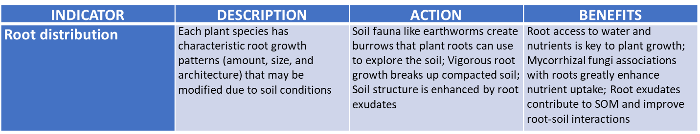
Roots
Notes:
Size, distribution, and health of plant roots are all important for supporting productive forage and tree growth.

Slide 22
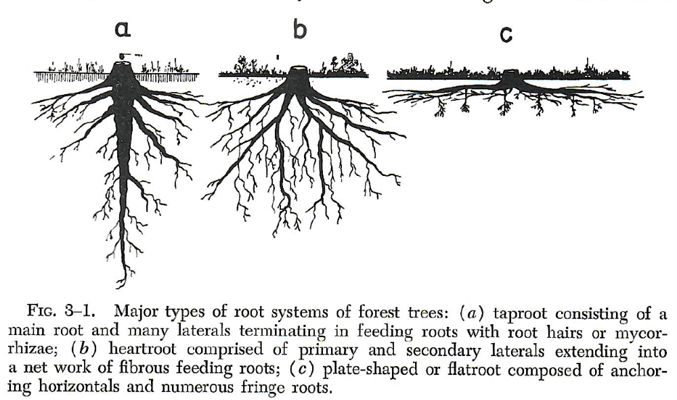
Tree Rooting Patterns
Taproot
Heartroot
Flatroot
Spruce & Hemlock
Pine, Black Walnut, & Oak
Maple, Beech, & Fir
Wilde, S. A. 1958. Forest Soils – Their Properties and Relation to Silviculture. The Ronald Press Company, New York. 537 pp.
Notes:
Wilde, S. A. 1958. Forest Soils – Their Properties and Relation to Silviculture. The Ronald Press Company, New York. 537 pp.

Slide 23
Tree Rooting Patterns 2
While trees have different rooting patterns, soil properties may have a dominant effect on rooting depth and radius
- restrictive layers (high bulk density, shallow groundwater, salt,
Al, bedrock)
Classification of tree species according to rooting depth in not well agreed upon, generally upland species are deeper rooted
Although tree roots have been measured to > 60 m(~200 ft!) most tree roots are found within 60 cm (2 ft)
Rough estimate of minimum rooting radius = drip line
Rather than maximum depth, consider effective depth = layer of depleted soil water (i.e. source of water & nutrient uptake)
Stone, E. L. and P. J. Kalisz. 1991. https://doi.org/10.1016/0378-1127(91)90245-Q
Notes:
Stone, E. L. and P. J. Kalisz. 1991. On the maximum extent of tree roots. Forest Ecol. Manage. 46:59-102. https://doi.org/10.1016/0378-1127(91)90245-Q

Slide 24
Temperate Silvopasture Soil Physical Health

Slide 25
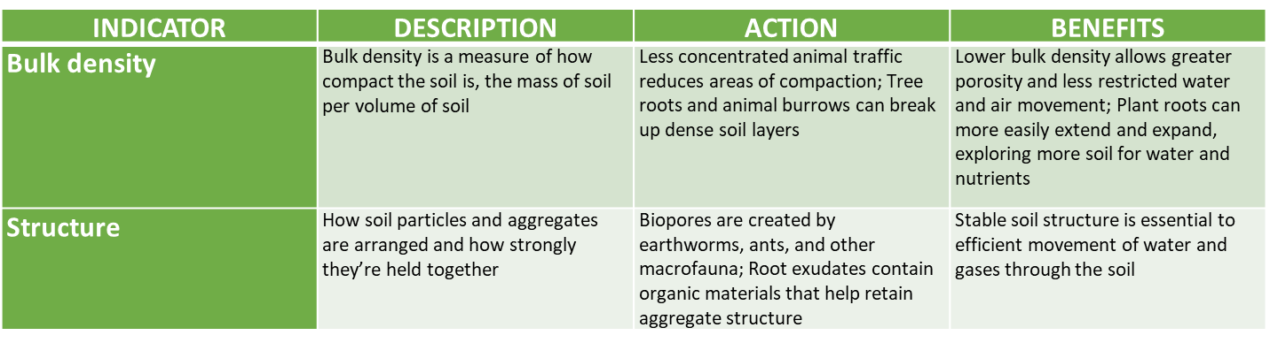
Soil Bulk Density and Structure
Notes:
Bulk density and soil structure affect soil porosity, which is critical for water and air flow to support plant and fauna growth.

Slide 26
Bulk Density & Structure
Sharrow (2007) found that, after 11 years of grazing by sheep, soils in a Douglas-fir/perennial ryegrass-subclover silvopasture has 13% higher bulk density (BD) and 7% lower porosity compared to ungrazed forest in Oregon
However, these properties of the silvopasture soils were comparable to the forest soils two years after grazing ceased
There were small detrimental effects of grazing on tree or forage growth in the silvopasture
Sharrow, S. H. 2007. Agroforestry Systems 71:215–223. DOI 10.1007/s10457-007-9083-4
Notes:
Sharrow, S. H. 2007. Soil compaction by grazing livestock in silvopastures as evidenced by changes in soil physical properties. Agroforestry Systems 71:215–223. DOI 10.1007/s10457-007-9083-4
Philomath silty clay (Vertic Haploxerol), which is a shallow (<35 mm deep), cracking clay developing above a basalt lava flow. These results may be a result of this soil type.

Slide 27
Bulk Density & Structure 2
Orefice et al (2017) also reported higher BD in silvopasture created by thinning a hardwood forest in New York
They attributed the increase in BD from 0.94 to 1.01 Mg m⁻³ to compaction by the timber harvesting equipment used during the tree thinning operation
Orefice, J., et al. 2017. Agroforestry Systems 91:729-739. DOI 10.1007/s10457-016-0040-y
Notes:
Orefice, J., R. G. Smith, J. Carroll, H. Asbjornsen, and D. Kelting. 2017. Soil and understory plant dynamics during conversion of forest to silvopasture, open pasture, and woodlot. Agroforestry Systems 91:729-739. DOI 10.1007/s10457-016-0040-y

Slide 28
Bulk Density & Structure
Stewart et al (2019) found no difference in BD to a depth of 30 cm between forest, pasture, or hardwood/orchard grass silvopasture soils in New Hampshire
Lack of differences were possibly due to the fine sandy loam texture of the soil
Stewart, A., A. et al. 2019. Agroforestry Systems https://doi.org/10.1007/s10457-019-00454-9
Due to the number and distribution of trees in silvopastures, grazing is more uniform, trails more dispersed, and animals less likely to concentrate for shade (summer) or shelter (winter) thereby reducing areas of high soil compaction from animal treading
A leaf litter layer and large tree roots near the soil surface may buffer some of the livestock treading, although excessive treading can also harm the tree roots
Notes:
Stewart, A., A. Coble, A. R. Contosta, J. N. Orefice, R. G. Smith, and H. Asbjornsen. 2019. Forest conversion to silvopasture and open pasture: effects on soil hydraulic properties. Agroforestry Systems https://doi.org/10.1007/s10457-019-00454-9

Slide 29
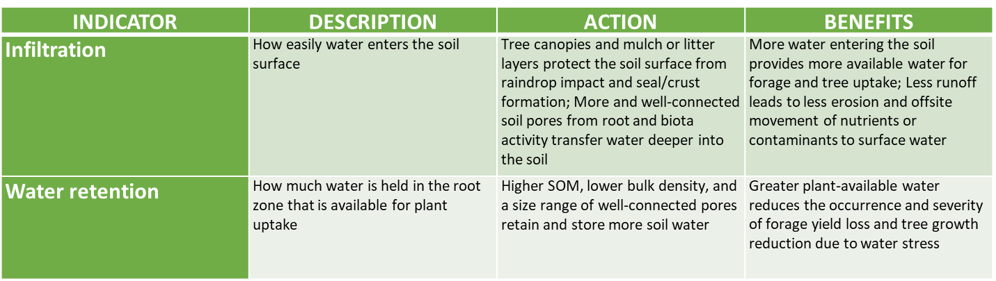
Infiltration and Water Retention
Notes:
Surface soil properties will determine infiltration rate while soil texture, SOM content, and soil structure affect how much plant available water is stored in the root zone.

Slide 30
Infiltration & Water Retention
Sharrow (2007) found that, after 11 years of grazing by sheep, soils in a Douglas-fir/perennial ryegrass-subclover silvopasture have 38% lower infiltration as compared to ungrazed forest in Oregon
These properties of the silvopasture soils were comparable to the forest soils two years after grazing ceased
Sharrow, S. H. 2007. Agroforestry Systems 71:215–223. DOI 10.1007/s10457-007-9083-4
Notes:
Sharrow, S. H. 2007. Soil compaction by grazing livestock in silvopastures as evidenced by changes in soil physical properties. Agroforestry Systems 71:215–223. DOI 10.1007/s10457-007-9083-4
Philomath silty clay (Vertic Haploxerol), which is a shallow (<35 mm deep), cracking clay developing above a basalt lava flow. These results may be a result of this soil type.

Slide 31
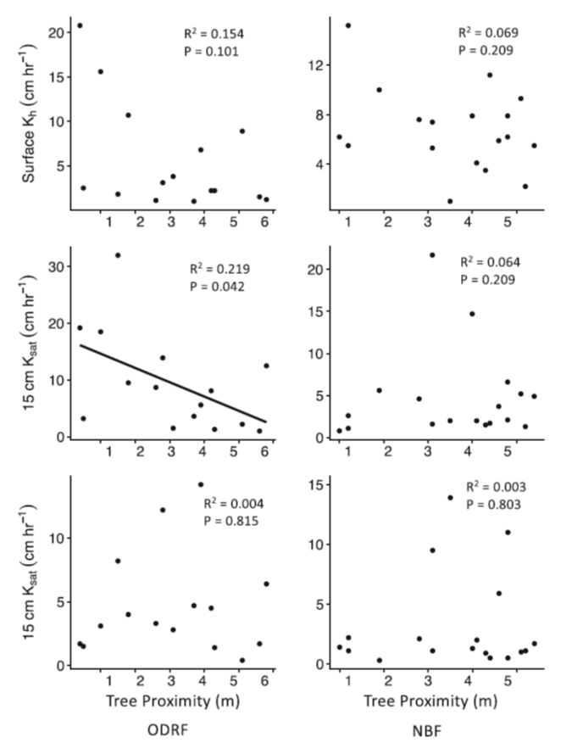
Infiltration & Water Retention
Stewart et al (2019) found few significant differences in surface infiltration or saturated hydraulic conductivity (K_{sat}) at 15 or 30 cm depths between forest, pasture, or hardwood/orchard grass silvopasture soils in New Hampshire.
There was a weak positive correlation between K_{sat} at 15 cm and proximity to trees in the silvopasture.
Higher infiltration beneath tree canopies is attributed to the tree canopy and litter layer protecting the soil surface from raindrop impact, strong, stable soil structure, and broad pore size distribution due to the activity of meso- and macrofauna (Binkley and Fisher, 2020).
30
Organic Dairy Research Farm North Branch Farm
Stewart, A., et al. 2019. Agroforestry Systems https://doi.org/10.1007/s10457-019-00454-9
Binkley, D. and R. F. Fisher. 2020. Ecology and management of forest soils. 5th Ed. John Wiley and Sons Ltd.
Notes:
Binkley, D. and R. F. Fisher. 2020. Ecology and management of forest soils. 5th Ed. John Wiley and Sons Ltd.
Stewart, A., A. Coble, A. R. Contosta, J. N. Orefice, R. G. Smith, and H. Asbjornsen. 2019. Forest conversion to silvopasture and open pasture: effects on soil hydraulic properties. Agroforestry Systems https://doi.org/10.1007/s10457-019-00454-9

Slide 32
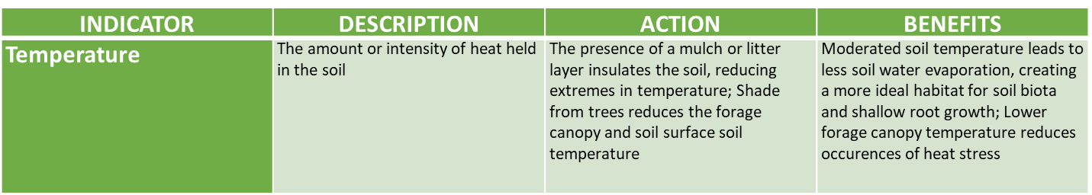
Soil Temperature
Notes:
Soil aabiotic factors (temperature and water content) have a significant affect on all soil biological and chemical processes.

Slide 33
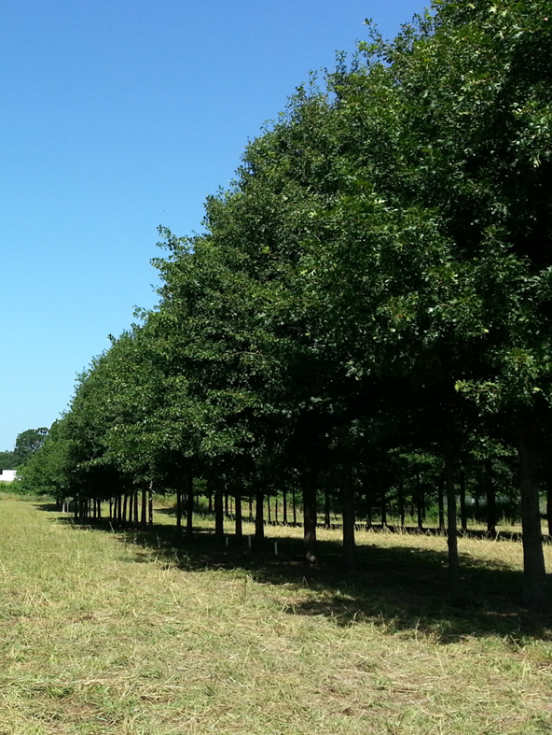
Soil Temperature 2
Shade from trees will move across the forage canopy over the course of the day (varies by row orientation)
Thin tree stand and/or prune lower branches to move shade away from trunk
Areas of high midday sunlight and water uptake will become drier and warmer
Notes:
Photo of oak trees in east-west oriented rows around mid-morning. Photo by Tom Sauer.

Slide 34
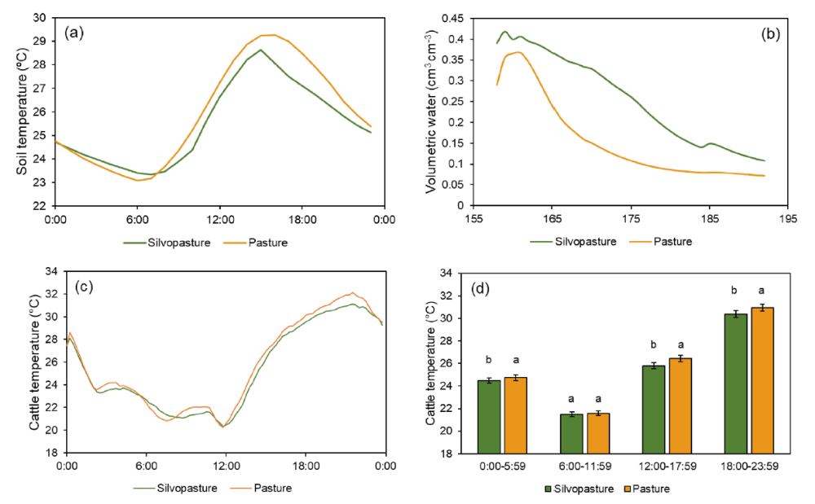
Soil Temperature & Water Content
June 7–July 11, 2022
Mean soil surface temperature in the silvopasture was lower (25.6 °C) than the conventional pasture (25.9 °C).
Mean soil volumetric water content was 0.24 cm³ cm⁻³ in the silvopasture, 51% higher than in the conventional pasture (0.16 cm³ cm⁻³).
Amorim, H. C. S. et al. 2023. Scientific Reports (2023)13:18658 https://doi.org/10.1038/s41598-023-45960-0
Notes:
Amorim, H. C. S., A. J. Ashworth, P. L. O’Brien, A. L. Thomas, B. R. K. Runkle, and D. Philipp. 2023. Temperate silvopastures provide greater ecosystem services than conventional pasture systems. Scientific Reports (2023)13:18658 https://doi.org/10.1038/s41598-023-45960-0

Slide 35
Temperate Silvopasture Soil Chemical Health
Notes:
Soil chemical processes are affected by soil physical properties and biological processes. Organic litter, roots, and fauna decompose to stable carbon forms and inorganic nutrients available for plant uptakes.

Slide 36
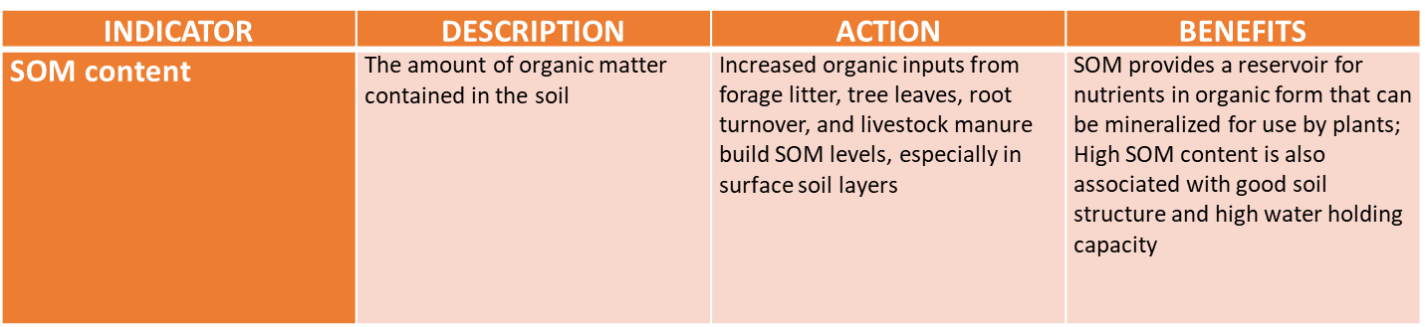
Soil Organic Matter Content
Notes:
SOM content is a key indicator of soil health. Soils that have increasing SOM are much more likely to be healthy than soils with decreasing amounts of SOM.

Slide 37
Silvopasture SOM
Amorim et al (2023) reported a SOM content of 3.22% in a hardwood/ orchardgrass silvopasture and 2.74% in a conventional orchardgrass pasture soil in Arkansas
Baah-Acheamafour et al (2014) found silvopasture soils had more SOC (81.3 g kg⁻¹) than hedgerow (62.5) and shelterbelt (47.7) soils in Alberta
Haile et al (2010), using stable C isotope techniques, found more tree-derived SOC in the fine fraction in a slash pine/bahiagrass silvopasture in Florida. The silvopasture soils had greater SOC than open pasture soils at all soil depths down to 1.25 m.
Amorim, H. C. S. et al. 2023. Scientific Reports (2023)13:18658 https://doi.org/10.1038/s41598-023-45960-0
Baah-Acheamfour, M. et al. 2014. Forest Ecol. Manage. 328:131-139. http://dx.doi.org/10.1016/j.foreco.2014.05.031
Haile, S. G. et al. 2010. Global Change Biology 16:427-438. doi: 10.1111/j.1365-2486.2009.01981.x
Notes:
Amorim, H. C. S., A. J. Ashworth, P. L. O’Brien, A. L. Thomas, B. R. K. Runkle, and D. Philipp. 2023. Temperate silvopastures provide greater ecosystem services than conventional pasture systems. Scientific Reports (2023)13:18658 https://doi.org/10.1038/s41598-023-45960-0
Baah-Acheamfour, M., C. N. Carlyle, E. W. Bork, and S. X. Chang. 2014. Trees increase soil carbon and its stability in three agroforestry systems in central Alberta, Canada. Forest Ecology and Management 328:131-139. http://dx.doi.org/10.1016/j.foreco.2014.05.031
Haile, S. G., V. D. Nair, and P. K. R. Nair. 2010. Contribution of trees to carbon storage in soils of silvopastoral systems in Florida, USA. Global Change Biology 16:427-438. doi: 10.1111/j.1365-2486.2009.01981.x

Slide 38
Silvopasture SOM 2
Sharrow and Ishmael (2004), at the same location as Sharrow (2007), reported that 11 years after planting, the silvopasture had accumulated 740 kg ha^{–1} yr ^{–1} more C than the forest plantation and 520 kg ha^{–1} year^{–1} more C than the pasture
- The forest plantation and silvopasture stored most of their C as
SOM with litter and tree biomass accounting for 12% and 9% of
total C in the silvopasture and forest plantations, respectively
Karki et al (2021) compared soil health indicators between a 5-year-old southern-pine silvopasture grazed by sheep and goats and 13-year-old southern-pine/hardwood woodland in northern Alabama. The silvopasture topsoil had significantly higher SOC as compared to the woodland.
Sharrow, S. H., and S. Ismail. 2004. Agroforestry Systems 60:123–130.
Sharrow, S. H. 2007. Agroforestry Systems 71:215–223. DOI 10.1007/s10457-007-9083-4
Karki, S. et al. 2021. Agroforestry Systems 95:227–240. https://doi.org/10.1007/s10457-020-00577-4
Notes:
Sharrow, S. H., and S. Ismail. 2004. Carbon and nitrogen storage in agroforests, tree plantations, and pastures in western Oregon, USA. Agroforestry Systems 60:123–130.
Sharrow, S. H. 2007. Soil compaction by grazing livestock in silvopastures as evidenced by changes in soil physical properties. Agroforestry Systems 71:215–223. DOI 10.1007/s10457-007-9083-4
Karki, S., R. Shange, R. Ankumah, W. McElhenney, O. Idehen, S. Poudel, and U. Karki. 2021. Comparative assessment of soil health indicators in response to woodland and silvopasture land use systems. Agroforestry Systems 95:227–240. https://doi.org/10.1007/s10457-020-00577-4

Slide 39
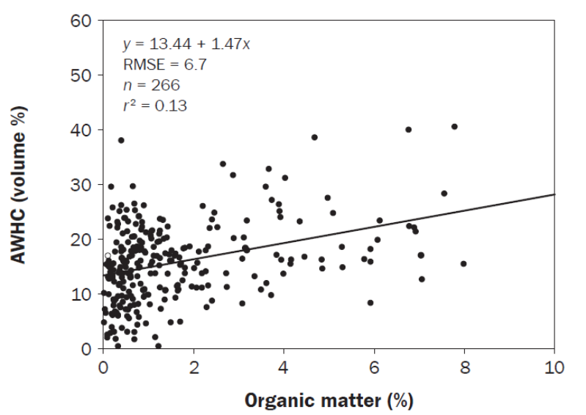
SOM & Available Water
Amorim et al (2023) reported a SOM content of 3.22% in a silvopasture and 2.74% in a pasture soil. This difference was estimated to increase available water holding capacity by 15%.
Libohova et al. 2018: “… the relationship between AWHC and SOM is complex and involves interactions between amounts of SOM, particle size, clay mineralogy, bulk density, and other factors.”
Sandy Soils (s, fs, ls)
Libohova et al., 2018.
Tree growth is often water- or energy-limited, not nutrient-limited
Amorim, H. C. S. et al. 2023. Scientific Reports (2023)13:18658 https://doi.org/10.1038/s41598-023-45960-0
Libohova, Z., et al. 2018. Journal of Soil and Water Conservation 73:411-421 doi:10.2489/jswc.73.4.411
Notes:
Amorim, H. C. S., A. J. Ashworth, P. L. O’Brien, A. L. Thomas, B. R. K. Runkle, and D. Philipp. 2023. Temperate silvopastures provide greater ecosystem services than conventional pasture systems. Scientific Reports (2023)13:18658 https://doi.org/10.1038/s41598-023-45960-0
Libohova, Z., C. Seybold, D. Wysocki, S. Wills, P. Schoeneberger, C. Williams, D. Lindbo, D. Stott, and P. R. Owens. 2018. Reevaluating the effects of soil organic matter and other properties on available water-holding capacity using the National Cooperative Soil Survey Characterization Database. Journal of Soil and Water Conservation 73:411-421 doi:10.2489/jswc.73.4.411

Slide 40
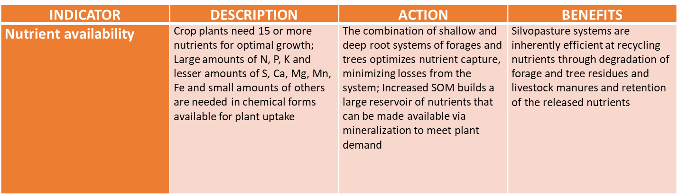
Nutrient Availability
Notes:
Mineralization of organic materials to inorganic nutrients in plant available form is essential for sustaining a productive silvopasture system.

Slide 41
Silvopasture & Nutrient Cycling
Silvopastures should accrete more C and N than forests or pastures because they may produce more total annual biomass and have active forest and grassland C and nutrient cycling systems (Sharrow and Ismail, 2004)
Forages extract inorganic nutrients from the soil that grazing animals consume and then redistribute most of those nutrients (80-90%) back across the landscape in organic forms in manure
Soil biota recycle the organic nutrients in manure, tree and forage litter, and root turnover into inorganic forms to complete the nutrient cycle
Sharrow, S. H., and S. Ismail. 2004. Agroforestry Systems 60:123–130.
Notes:
Sharrow, S. H., and S. Ismail. 2004. Carbon and nitrogen storage in agroforests, tree plantations, and pastures in western Oregon, USA. Agroforestry Systems 60:123–130.

Slide 42
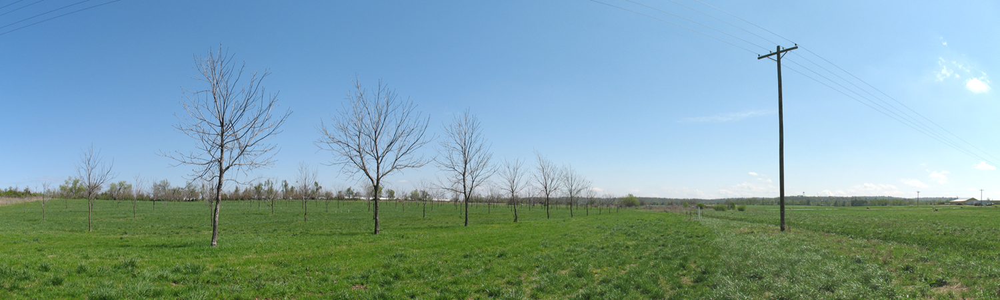
Silvopasture & Nutrient Cycling 2
The spatial distribution of nutrients can be influenced by topography and terrain attributes as they affect plant productivity, livestock grazing patterns, and surface water flow (Adhikari et al., 2018; Ashworth et al., 2022)
Adhikari, K., et al. 2018. Agrosystems Geoscience and Environment 1:180008 doi:10.2134/age2018.04.0008
Ashworth, A. J., et al. 2022. Scientific Reports 12:3508 https://doi.org/10.1038/s41598-022-07366-2
Notes:
Adhikari, K., P. R. Owens, A. J. Ashworth, T. J. Sauer, Z. Libohova, J. L. Richter, and D. M. Miller. 2018. Topographic controls on soil nutrient variations in a silvopasture system. Agrosystems Geoscience and Environment 1:180008 doi:10.2134/age2018.04.0008
Ashworth, A. J., T. Kharel, T. Sauer, T. C. Adams, D. Philipp, A. L. Thomas, and P. R. Owens. 2022. Spatial monitoring technologies for coupling the soil plant animal nexus. Scientific Reports 12:3508 https://doi.org/10.1038/s41598-022-07366-2

Slide 43
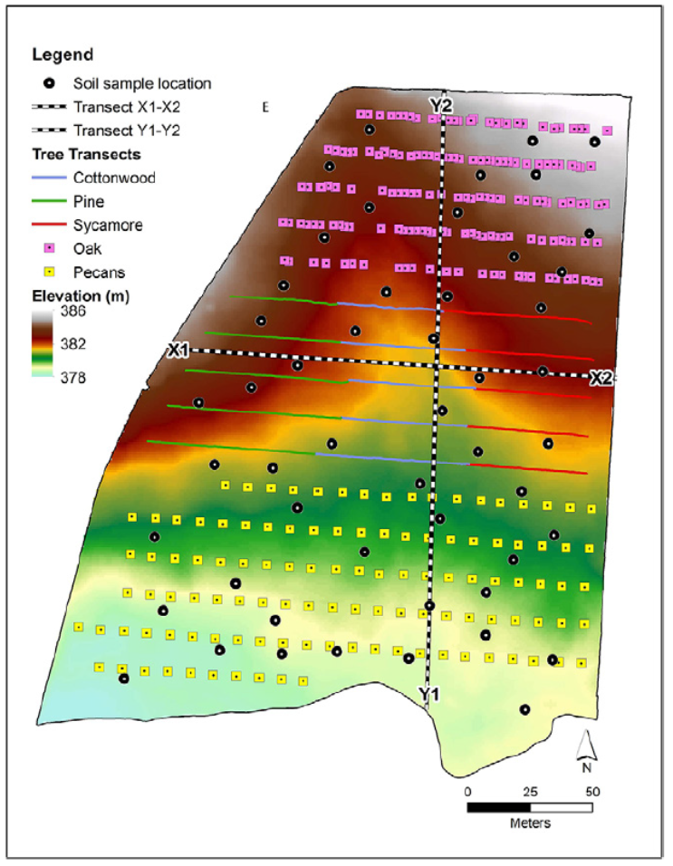
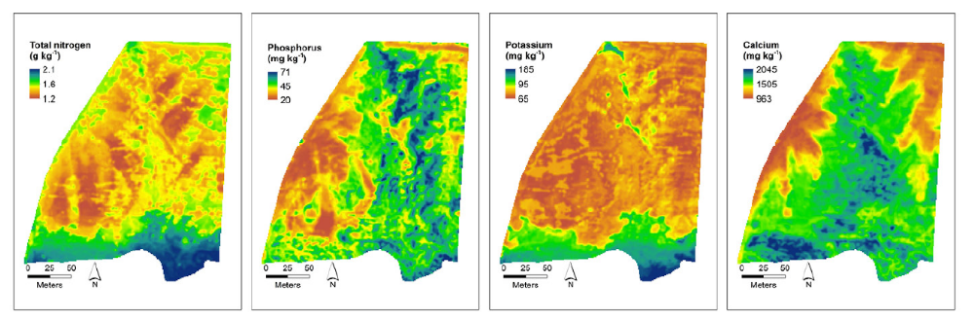
Silvopasture Nutrient Distribution
Nitrogen
Phosphorus
Terrain attributes affect water flow and nutrient movement
More mobile nutrients (e.g., N) are more evenly distributed
Less mobile nutrients (e.g., P) are less well distributed
More uniform grazing will help redistribute nutrients through manure depositions
Adhikari, K., et al. 2018. Agrosystems Geoscience and Environment 1:180008 doi:10.2134/age2018.04.0008
Notes:
Adhikari, K., P. R. Owens, A. J. Ashworth, T. J. Sauer, Z. Libohova, J. L. Richter, and D. M. Miller. 2018. Topographic controls on soil nutrient variations in a silvopasture system. Agrosystems Geoscience and Environment 1:180008 doi:10.2134/age2018.04.0008

Slide 44
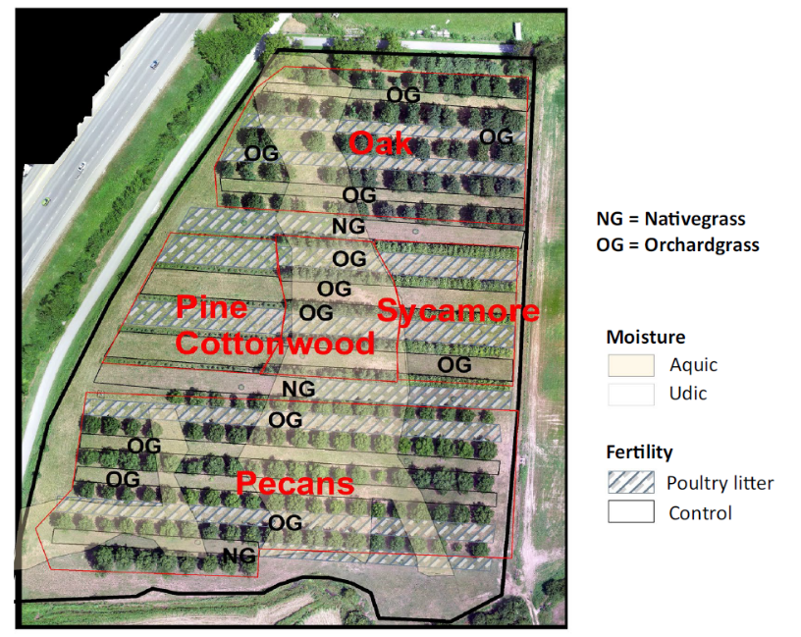
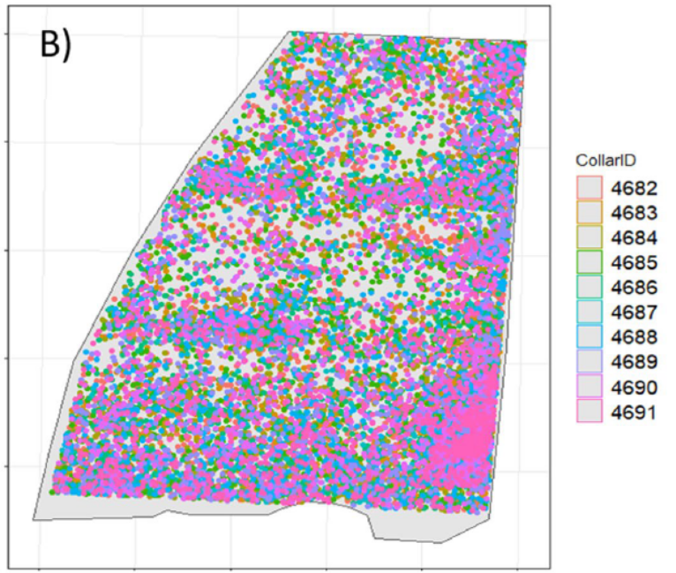
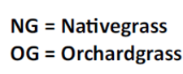
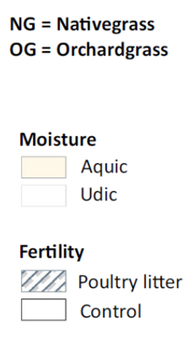
Grazing Patterns
2018
Native
Grass
Strips
Water
Source
Each dot = heifer lowered head
Cattle prefer grazing native grasses and udic (dry) landscape positions
Soils with greater grazing frequency had higher P and K contents
Forages had less lignin at lower elevations and greater tree height and diameter (shade) during summer mob grazing
Ashworth, A. J., et al. 2022. Scientific Reports 12:3508 https://doi.org/10.1038/s41598-022-07366-2
Notes:
Ashworth, A. J., T. Kharel, T. Sauer, T. C. Adams, D. Philipp, A. L. Thomas, and P. R. Owens. 2022. Spatial monitoring technologies for coupling the soil plant animal nexus. Scientific Reports 12:3508 https://doi.org/10.1038/s41598-022-07366-2

Slide 45
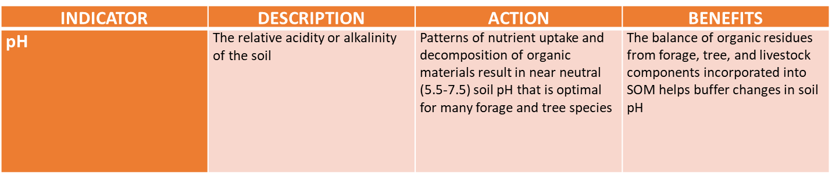
Soil pH
Notes:
Soils have a natural pH that is affected by management. Many plants have a preferred pH range and solubility of chemical forms of some nutrients are also affected by soil pH. Generally, extremes in pH should be avoided.

Slide 46
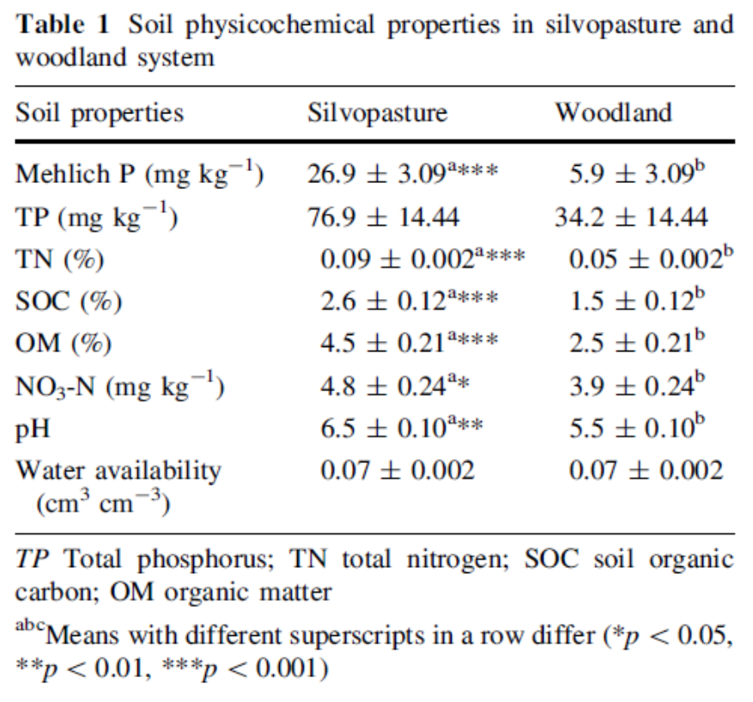
Silvopasture & Soil pH
Karki et al (2021) compared soil health indicators between a 5-year-old southern-pine silvopasture grazed by sheep and goats and 13-year-old southern-pine/hardwood woodland in northern Alabama.
The silvopasture topsoil had significantly higher SOC, total N, available phosphorous (P), nitrate N, and pH as compared to the woodland.
Karki, S. et al. 2021. Agroforestry Systems 95:227–240. https://doi.org/10.1007/s10457-020-00577-4
Notes:
Karki, S., R. Shange, R. Ankumah, W. McElhenney, O. Idehen, S. Poudel, and U. Karki. 2021. Comparative assessment of soil health indicators in response to woodland and silvopasture land use systems. Agroforestry Systems 95:227–240. https://doi.org/10.1007/s10457-020-00577-4

Slide 47
Silvopasture & Soil Health - Summary
Silvopasture systems provide shade and/or shelter for livestock, enhance beneficial organisms and diversity, increase carbon storage, and provide other ecosystem services
Silvopasture systems integrate forage, livestock, and tree components providing opportunities to improve soil health by enhancing biological activity and efficient nutrient cycling
Selected biological, physical, and chemical indicators of soil health, individually and in association, can be used to assess silvopasture soil health
Incorporating soil health principles into silvopasture management strategies will help maintain or restore soil health
Notes:
Important to emphasize that managing the forage, livestock, and tree components of silvopastures offer many opportunities to enhance soil health while building a productive and resilient agroecosystem.

Slide 48
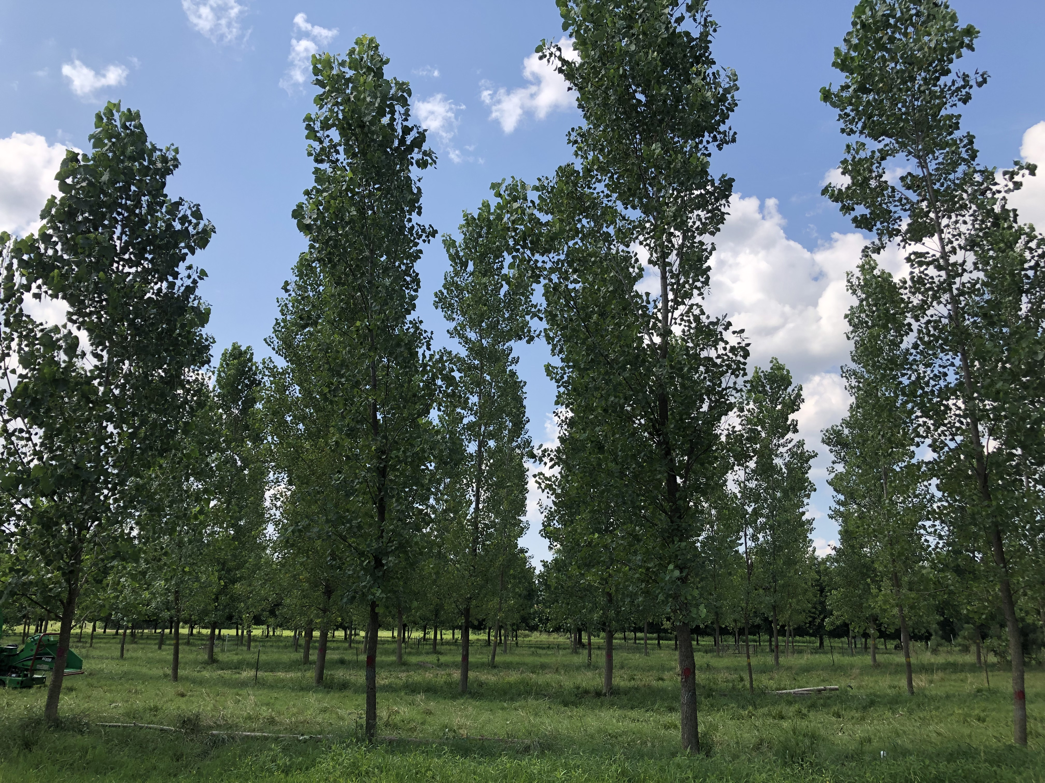
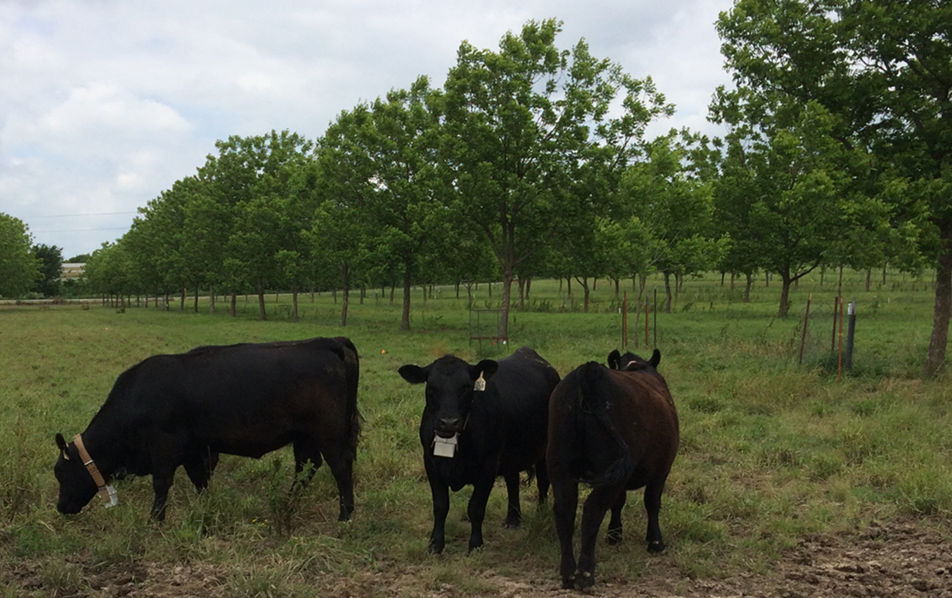
Questions
Notes:
Photo Credits: Tom Sauer, Soil Health Division.

Slide 49
Thank you!
For more information on Managing Soil Health,
visit us here:
https://www.nrcs.usda.gov/conservation-basics/natural-resource-concerns/soils/soil-health
USDA is an equal opportunity provider, employer, and lender.

